Slide 1
Parametric System Identification
Comparison of techniques to identify the parameters of a dynamic process
Notes:
© Copyright Showeet.com – Free PowerPoint Templates

Slide 2
Theory

Slide 3
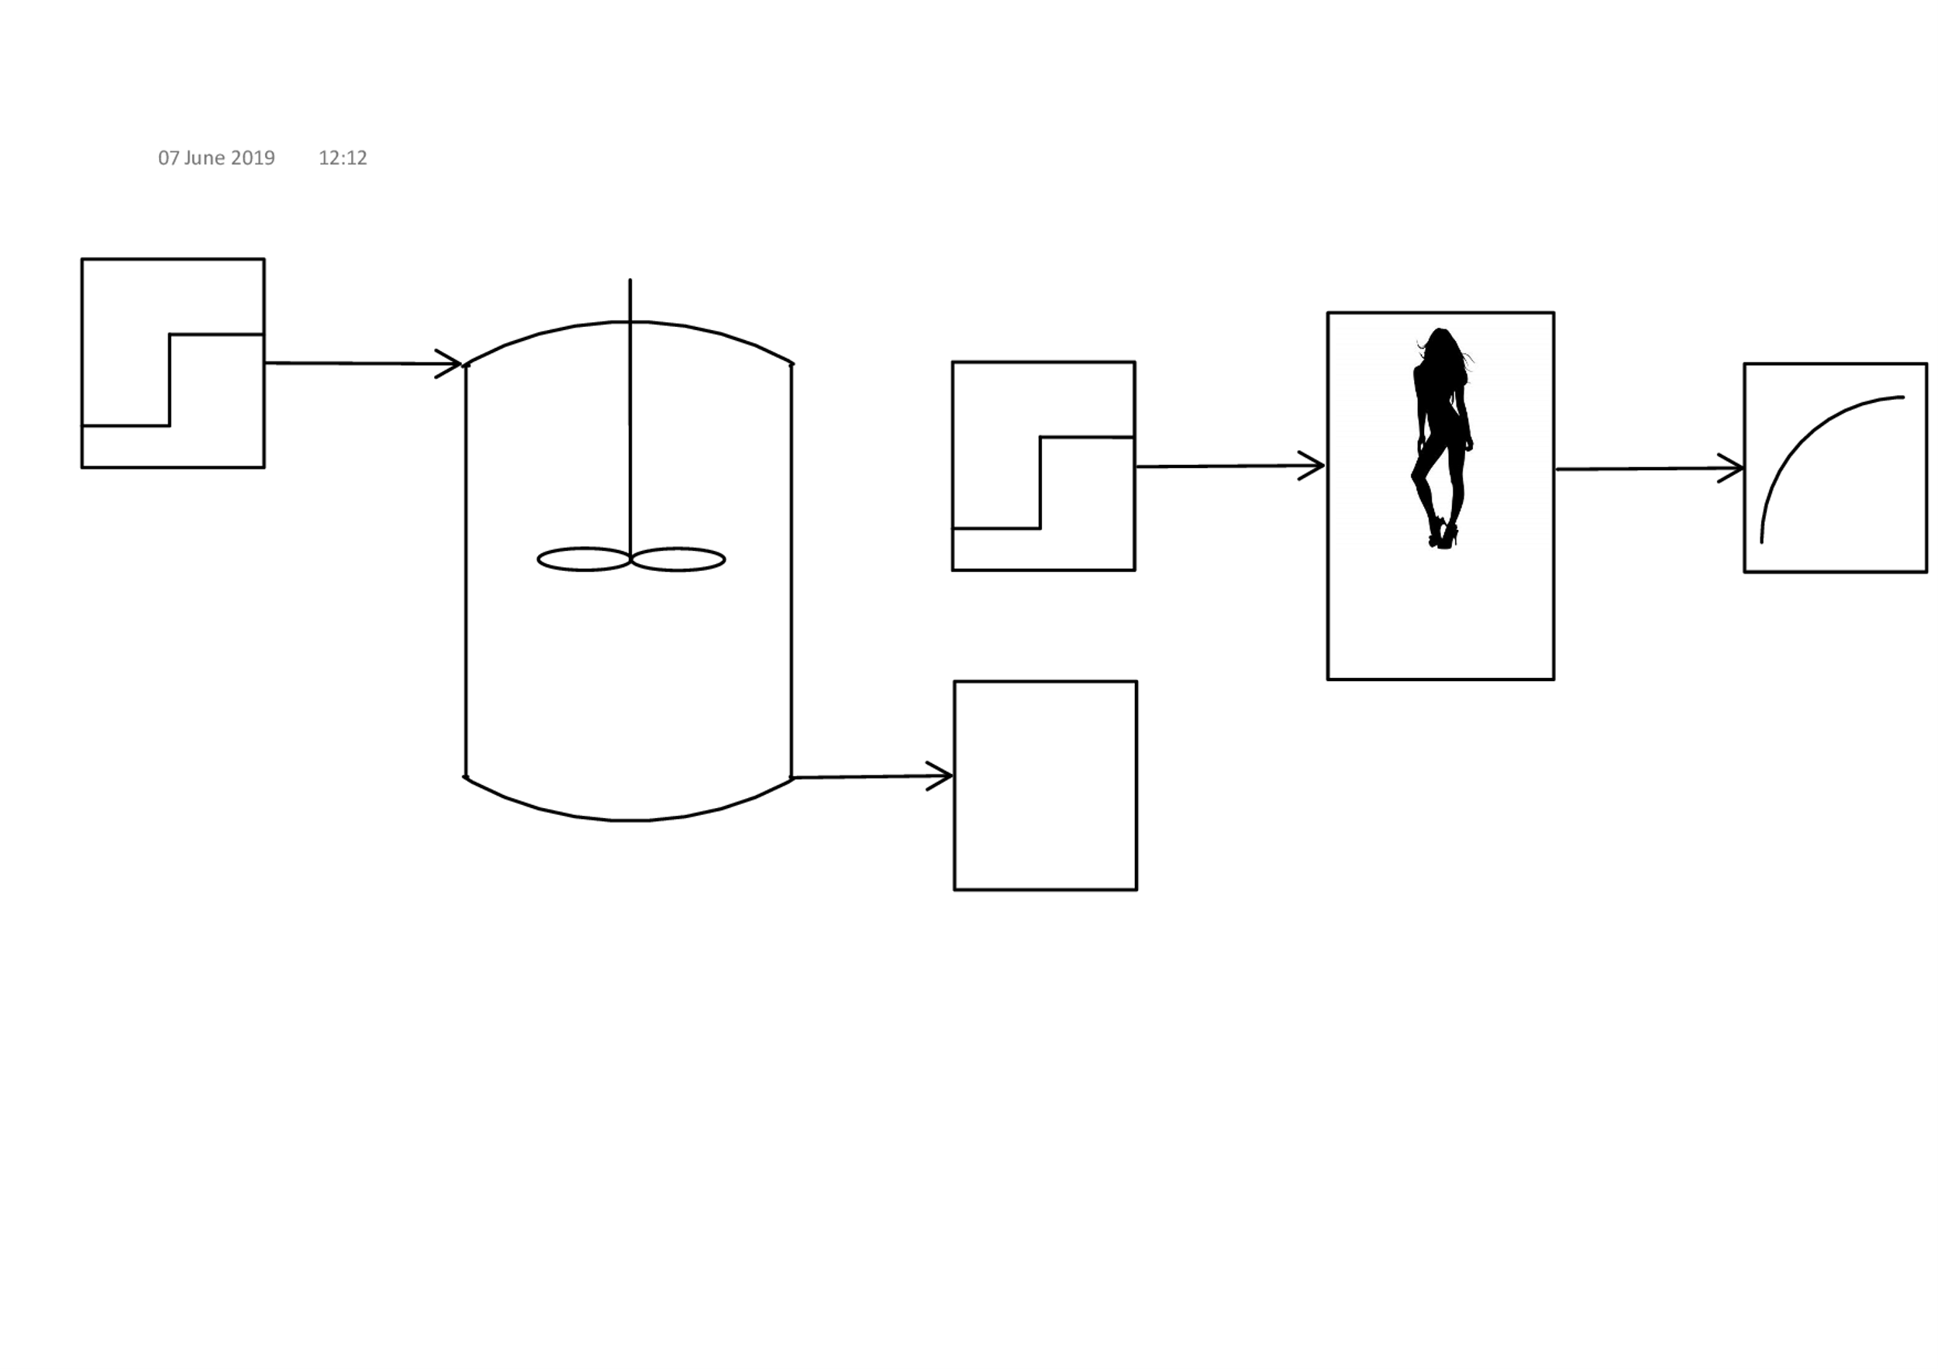
Parametric Identification Definition
System models describe the dynamics of a process.
Identification involves finding the parameters of a model.
Dynamic models aid in process control.
Model
?
Notes:
Why? Need math model that describe the dynamics of a process.

Slide 4
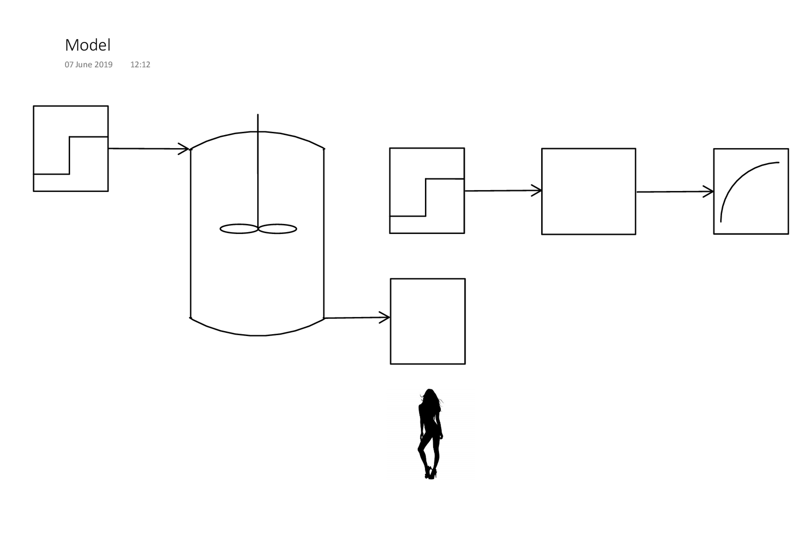

Parametric Identification Definition
System models describe the dynamics of a process.
Identification involves finding the parameters of a model.
Dynamic models aid in process control.
$$\frac{K}{τS+1}$$
?
Notes:
When there are no physical relationships available, it might be necessary to estimate this by analyzing the input-output data. Identification techniques enable us to develop mathematical models that aim to describe the system. If these models are accurate enough, we are then able to predict how a physical process will respond when changes occur in it’s state.

Slide 5
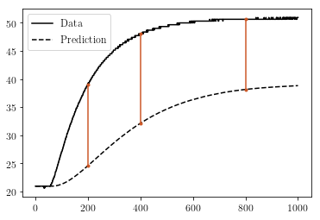
Identification Techniques
PEM
Aims to minimize the difference of predicted and real output.
Linear Regression
A PEM
Notes:
In the past, prediction error methods were popular because they are simple. The output of a certain model is compared to the real data. This model is then adjusted with the goal to decrease the difference in the real and predicted output. They were investigated to bring perspective on why it is necessary to involve more complicated algorithms.

Slide 6
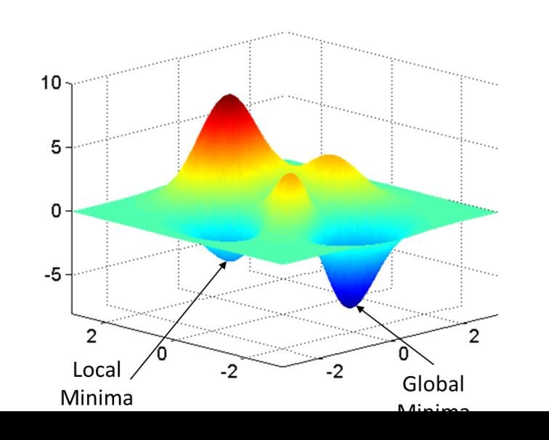
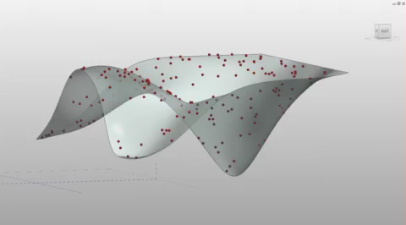
Identification Techniques
Optimization
Minimization: Sequential quadratic programming (SQP)
Differential Evolution.
Local minimum
Global minimum
Notes:
Optimization algorithms utilize an objective function that must be maximized or minimized. In this project, the objective function was the difference between the real output and the predicted output. This difference needed to be minimized. Sequential quadratic programming is a time efficient algorithm and also requires little computer processing power. But it only finds a local minimum, that is the immediate minimum value within one set of possible solutions. DE requires more computer memory, but it is capable of finding the global solution.

Slide 7
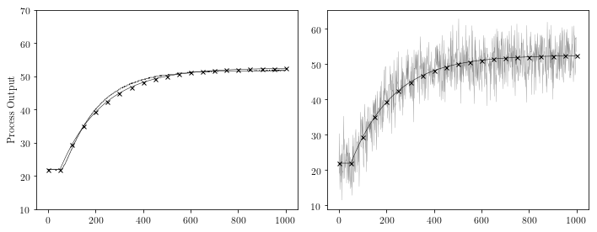
Comparison of Identification Techniques
Robust:
Unaffected by changes in system inputs or disturbances.
Run time:
How fast the algorithm produces results.
Notes:
The ID techs were compared in terms of rob and speed. Robustness is the measure of the algorithms ability to accurately predict the process response in spite of challenges such as input variations, inaccurate or faulty sensors and noisy data. Then it is also necessary to judge the algorithm based on how long it takes to produce a suitable model.

Slide 8
Results

Slide 9
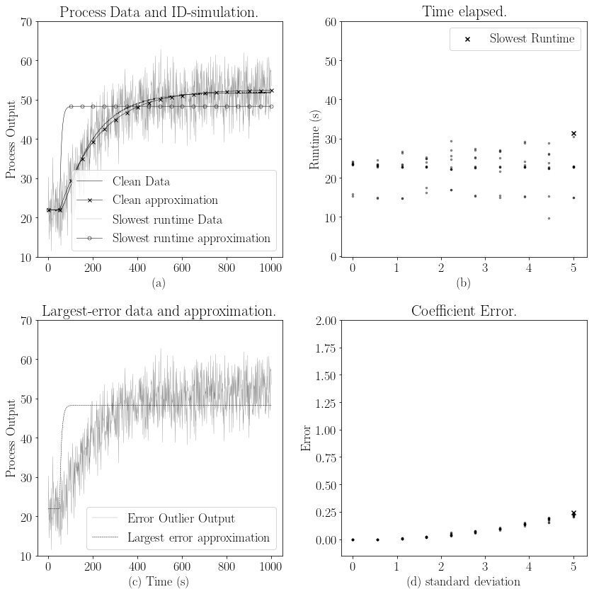

Linear Least Squares Regression
x
Goodness of fit
x
Poor Performance
Small margin for error
x
Notes:
Goodness of fit is how accurate the simulation is.

Slide 10
Linear Least Squares Regression
x
Time Delay
Notes:
The prediction is slightly to the right of the real data. Not perfect because the impression that the process responds slower is created.

Slide 11

Linear Least Squares Regression
x
Goodness of fit
x
Poor Performance
Small margin for error
x
Notes:
LSTSQ succeeded in determining a similar shape as the noisy data, but the prediction quality deteriorated rapidly with a small change in the model.

Slide 12
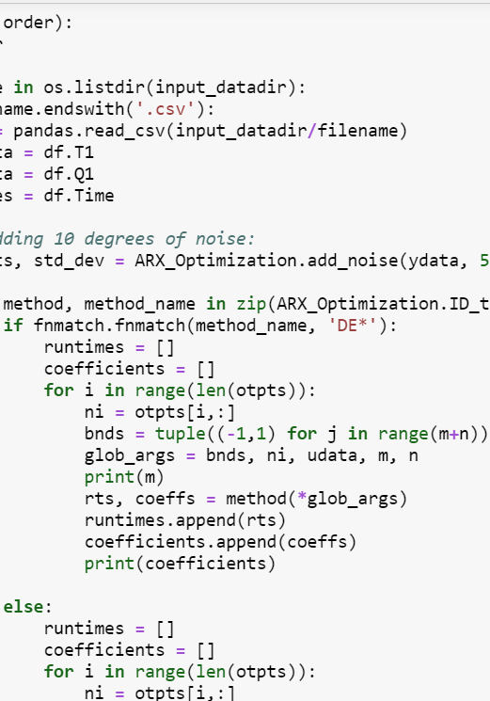
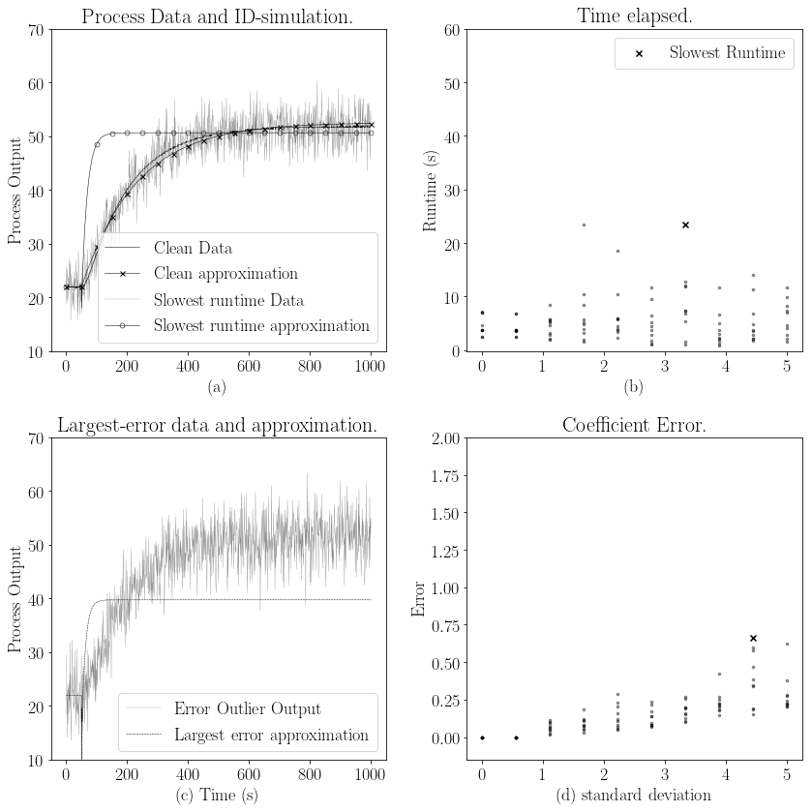
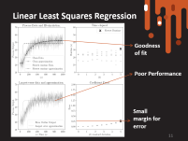
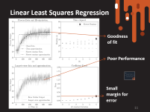
Sequential Quadratic Programming
x
x
Faster than LS
Poor Fit
x
Larger Error
Notes:
With no noise, the SQP fit is very similar to LS. SQP was in fact faster than LS, but less accurate. The difference in coefficients became larger as the noise increased. Ave runtime of 25s vs ave rt of 5s.

Slide 13
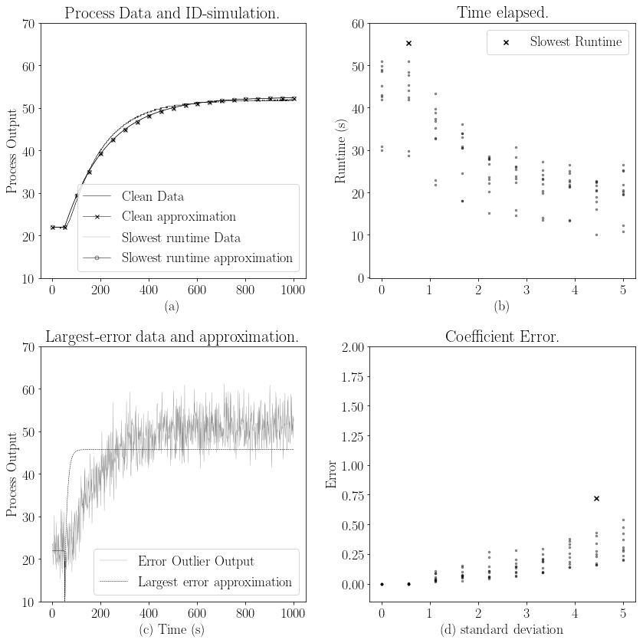


Differential Evolution
Decrease in runtime
Increase in coefficient error
Converging to local minimum
x
x
x
Notes:
DE showed a decrease in run time as the noise increased. Furthermore, the coeff err increased with increase in noise. One of the pitfalls of DE is that it isn’t always possible to find the global minimum. The algorithm more readily settles on a local minimum. Therefore it seems that the runtime is faster with increased noise.

Slide 14
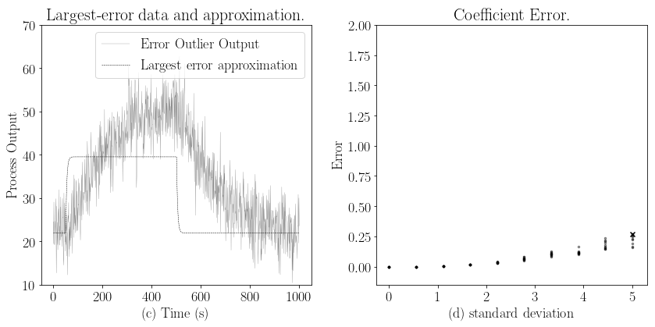

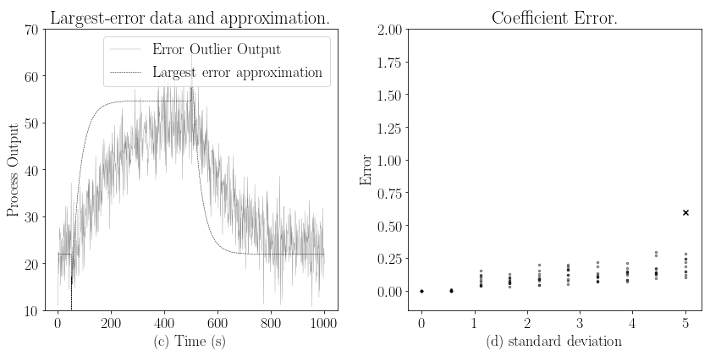

Differential Evolution
Higher order improved the prediction.
No significant change in LS or SQP.
x
x
Notes:
DE was also sensitive to the model instance. This was not the case for LS or SQP. The second order ARX model provided a more accurate fit to the first order model.

Slide 15
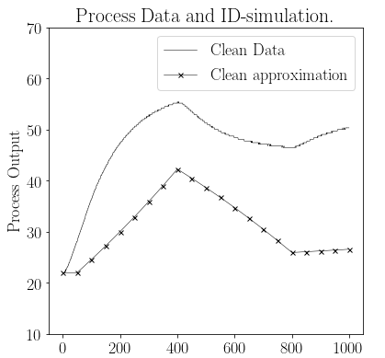


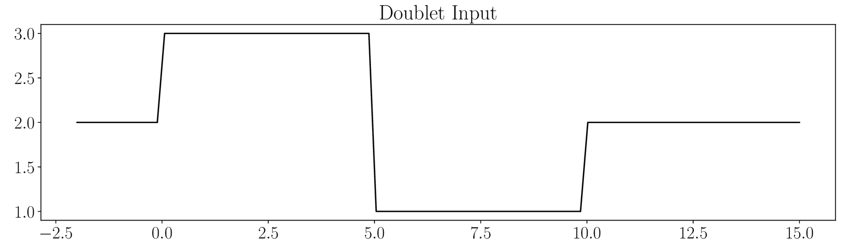
Struggle with input variation
Least Squares (LS)
SQP
Differential Evolution
Notes:
None of the algorithms were able to predict the process response when multiple input changes were made. These are the results to the doublet input and no measurement noise was present.

Slide 16
Conclusion
Least squares was sensitive to measurement noise
SQP was the fastest and allowed larger margin for error.
No significant improvement in fit.
DE was more robust, but slower.
None handled input variation well.
Notes:
Least squares is a simpler algorithm than SQP, but if computing time were important, I’d recommend SQP. DE showed the slowest run-time as was expected, although it had the most potential to deal with measurement noise and some input variation. Different techniques should be studied with the focus on multiple input changes and also disturbances.

Slide 17

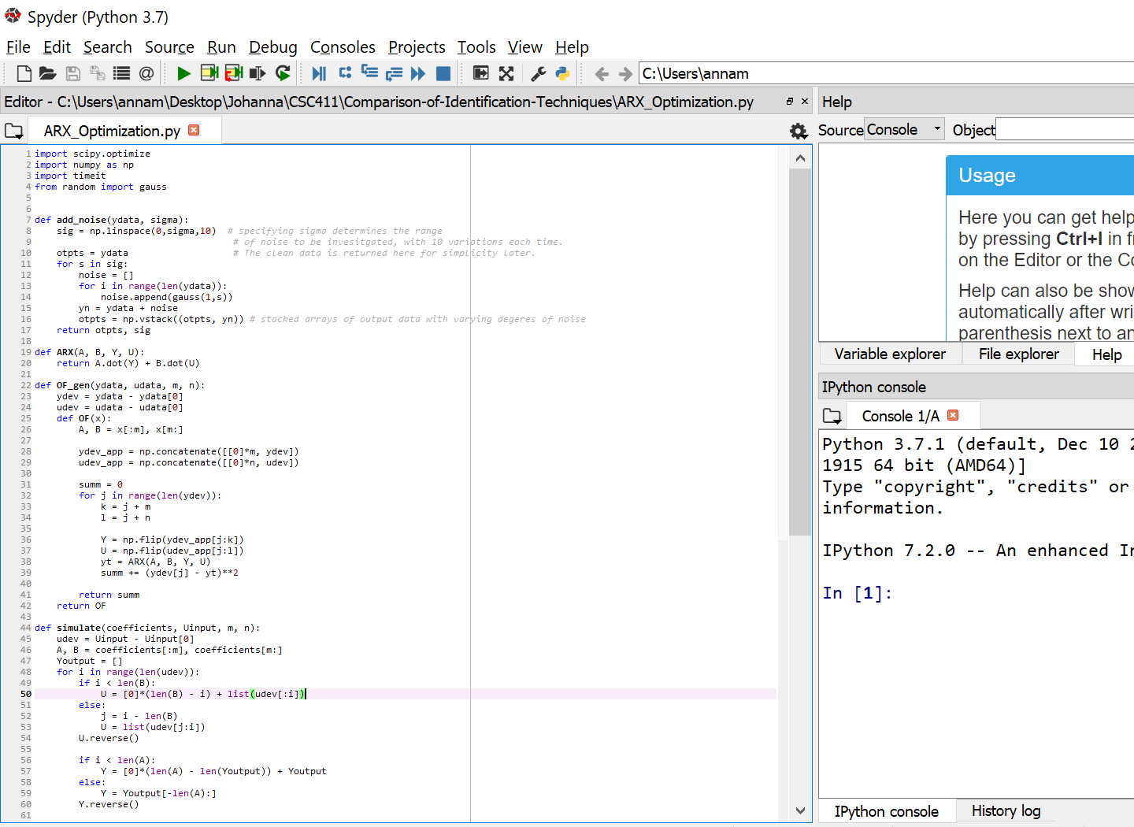
Thank You
Notes:
© Copyright Showeet.com – Free PowerPoint Templates

Slide 18

ARX
$$y_{p}=a_{1}y_{p}\left(t−1\right)+b_{1}u\left(t−1\right)$$
$$y_{p}=a_{1}y_{p}\left(t−1\right)+a_{2}y_{p}\left(t−2\right)+b_{1}u\left(t−1\right)+b_{2}u(t−2)$$
$$Error={a1}_{clean}−{a1}_{noisy}$$
Notes:
Here we have the ARX equations, 1st and 2nd order. The coefficient error was calculated …

Slide 19

LS math
$$R^{2}=\sum_{i=1}^{n}{{(y_{i} −y_{pi}^{})}^{2}}$$
$$\frac{dR^{2}}{dy}=0$$

Slide 20

SQP
$$y=ax^{2}+bx+c$$
$$\frac{dy}{dx}=0$$
$$\frac{d^{2}y}{dx^{2}}>0$$

Slide 21
DE
Random points
Possible solutions of OF
First estimate of minimum`

Slide 22
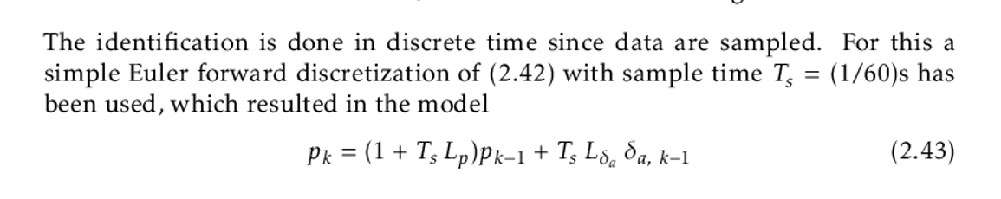
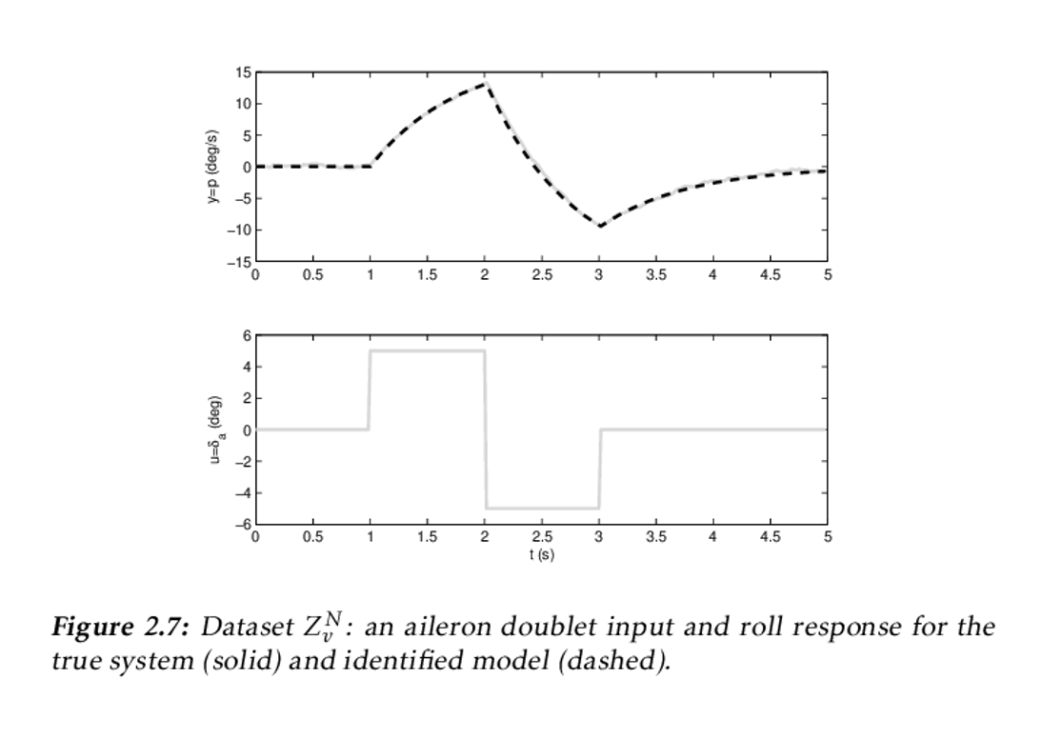
Doublet Explanation
Reference:
R Larsson, Linköping Studies in Science and Technology (2013), System Identification of Flight Mechanical Characteristics, Division of Automatic Control Department of Electrical Engineering , DOI: http://www.diva-portal.org/smash/get/diva2:622859/FULLTEXT01.pdf

Slide 23
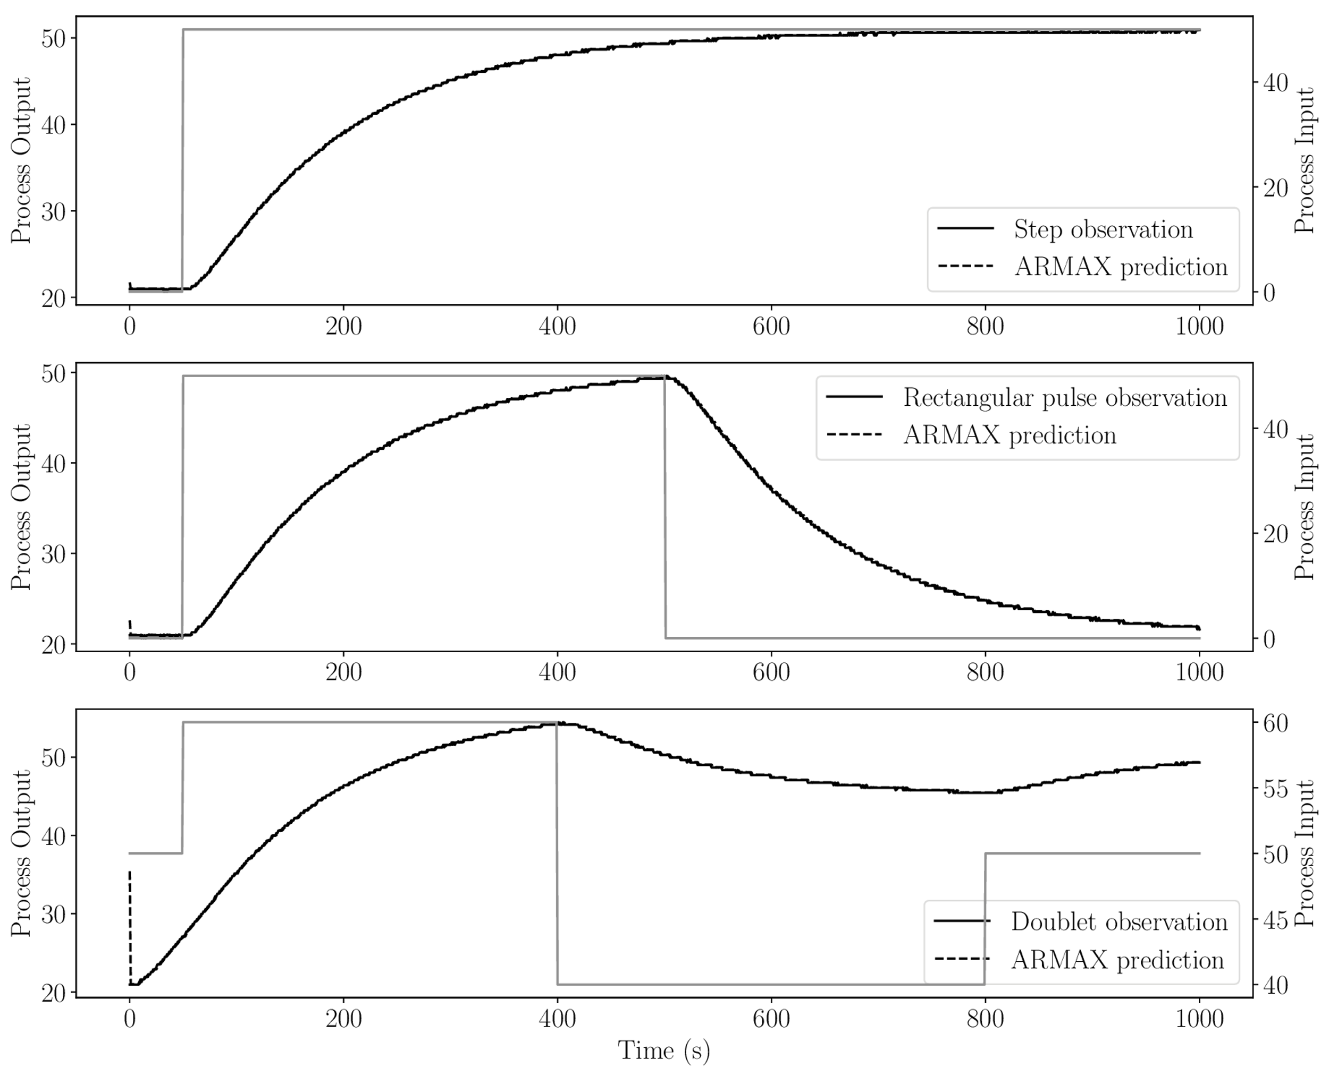
ARMAX
Notes:
Weighted ave of past inputs

